Slide 1
Tallest 10 Buildings in the World
By: Rayan Mo. Khair

Slide 2
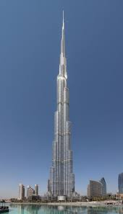
Burj Khalifa
Burj Khalifa is the tallest building in the world and its located in Dubai

Slide 3
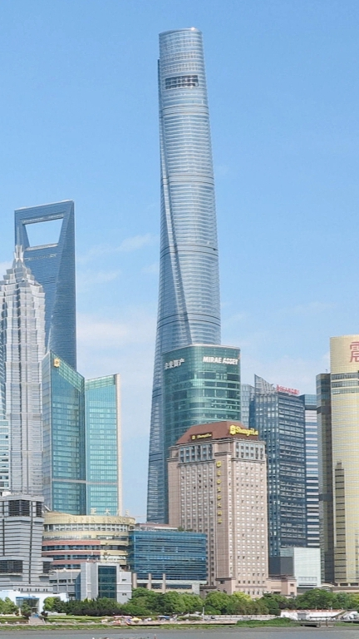
Shanghai Tower.
Shanghai Tower is the Second Tallest in the World

Slide 4
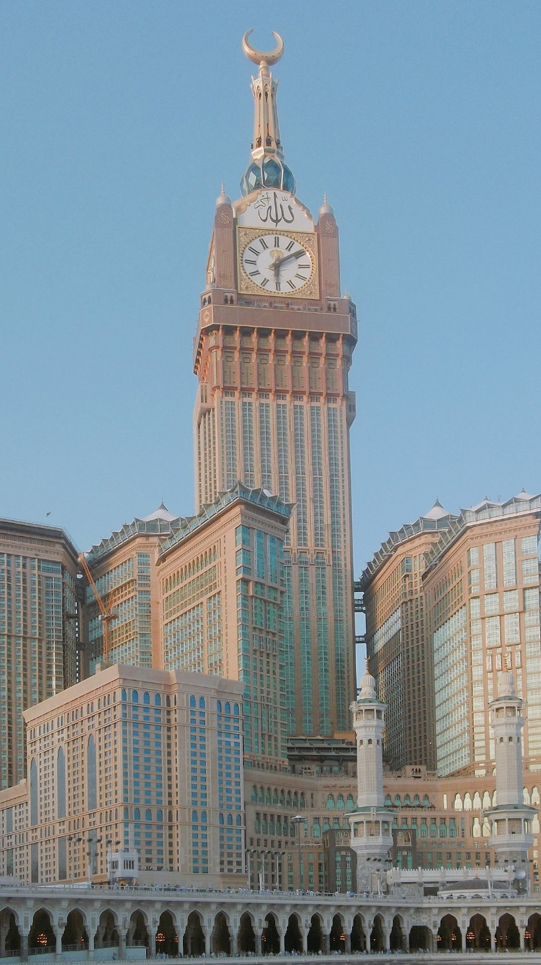
Abraj Al-Bait Clock Tower.
Abraj Al-Bait Clock Tower Is the Third Tallest tower in the world and its Mecca

Slide 5
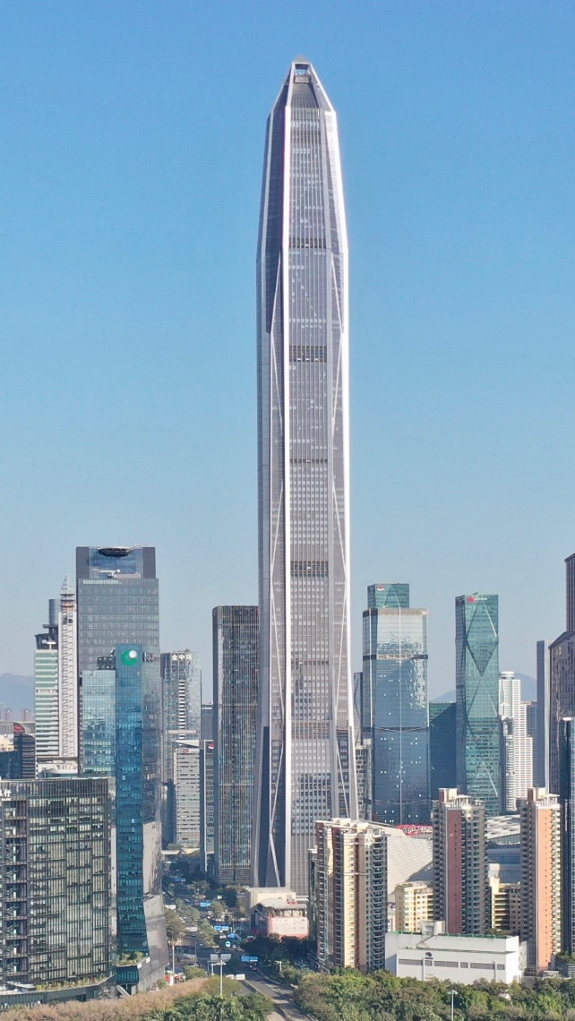
Ping An International Finance Centre.
Ping An International Finance Centre Is the fourth Tallest tower in the world

Slide 6
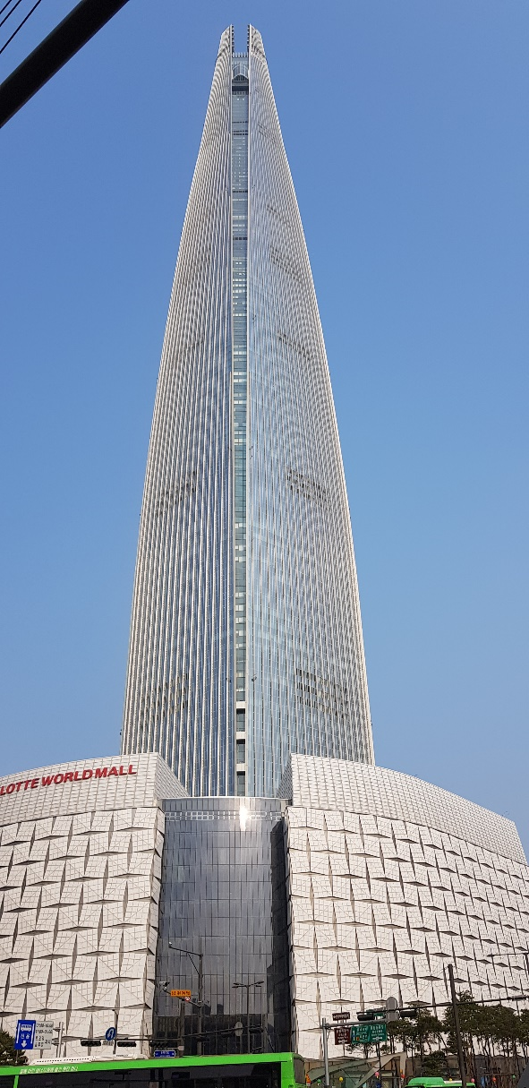
Lotte World Tower.
Lotte World Tower Is the fifth Tallest tower in the world

Slide 7
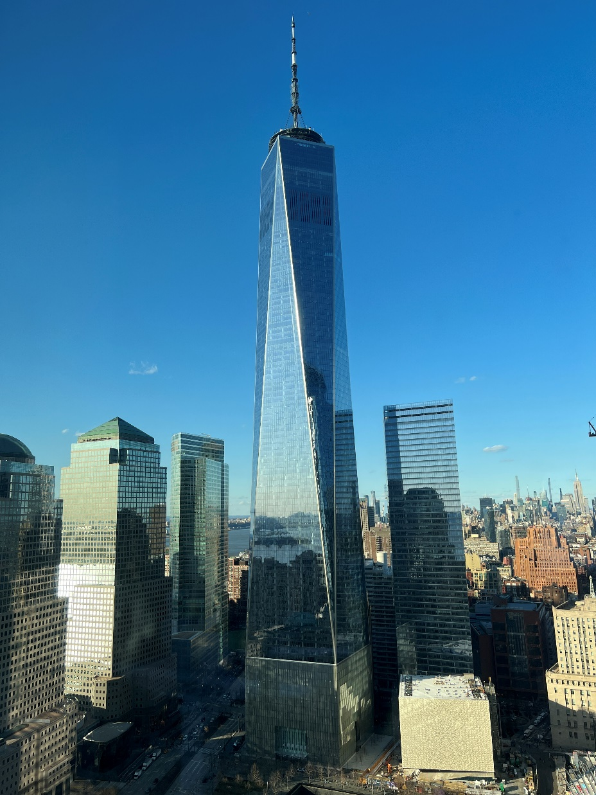
One World Trade Center
One World Trade Center Is the six Tallest tower in the world

Slide 8
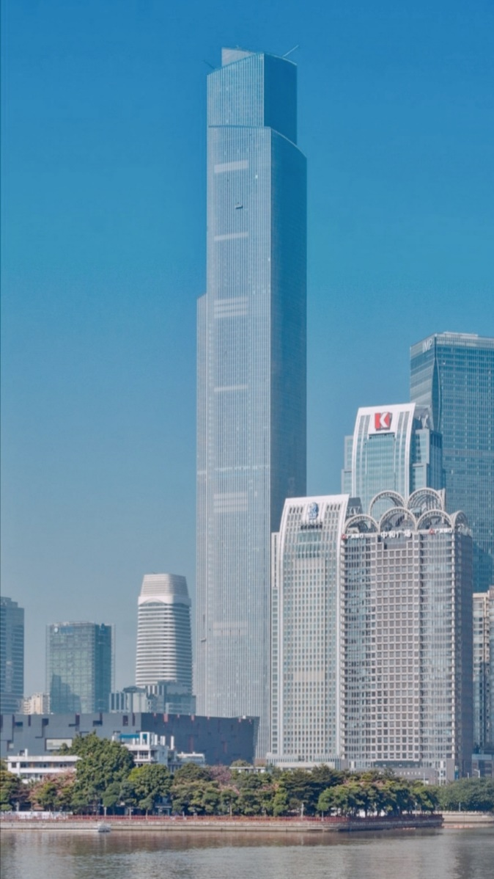
Guangzhou CTF Finance Centre
Guangzhou CTF Finance Centre Is the seven Tallest tower in the world

Slide 9
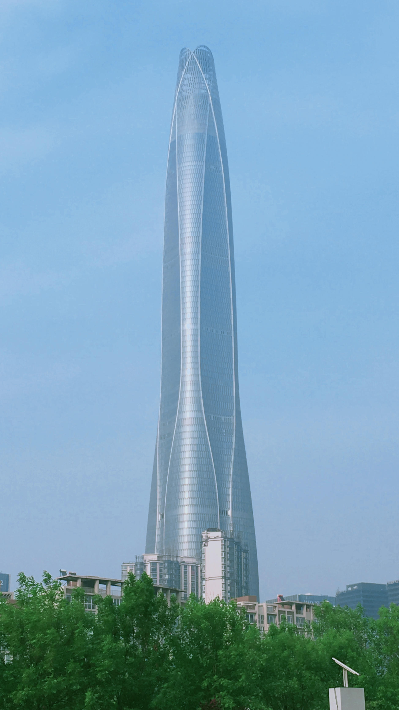
Tianjin CTF Finance Centre
Tianjin CTF Finance Centre Is the eighth Tallest tower in the world

Slide 10
Good Bye

